Slide 1
Analytics Vidya Health Care Analytics II
Null Hypothesis - The average amount of patients in the Hospital stays for 21-30 days.

Slide 2
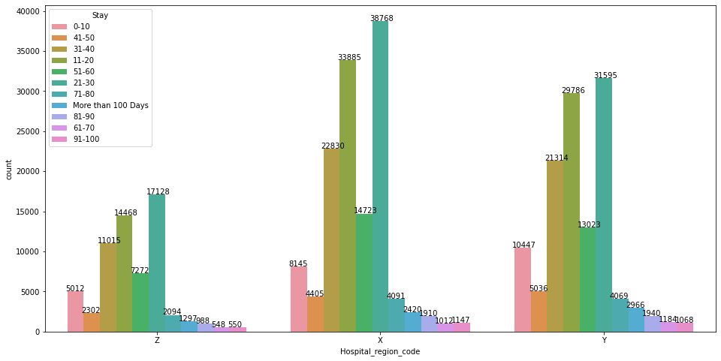
Observations:
* Most of the patients stays for 21-30 days in the hospital in the respective Hospital Region Code.

Slide 3
Observations:
* Y region has less number of hospital, we can start hospital in that area to improve business.

Slide 4
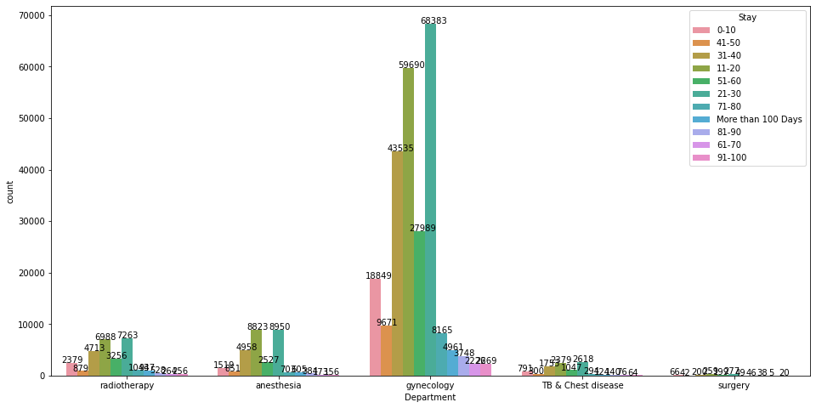
Observations:
* Gynecology Department has more number of case registered, so most number patients are female.

Slide 5
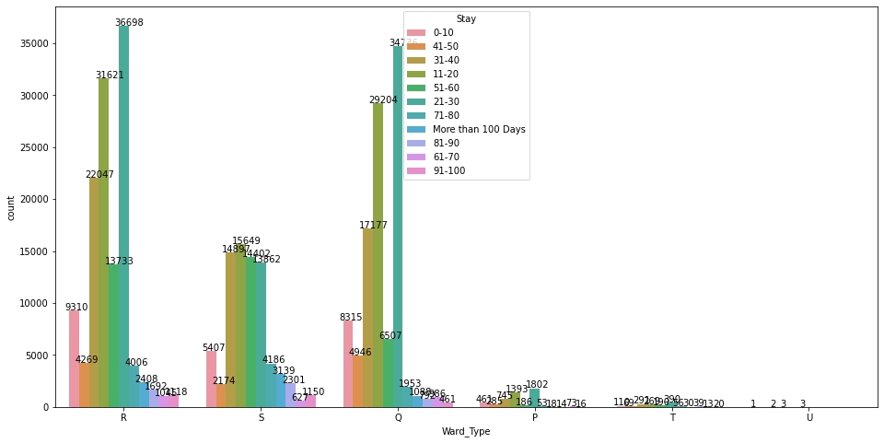
Observation:
* In S ward type, more percentage of patients stay for 11-20 days
* In U ward type there is only limited labels of stay, where patients probably stay for 11-20 days or 21-30 days.

Slide 6
Observation:
* In C type ward facility patients stay mostly 11-20 days.

Slide 7
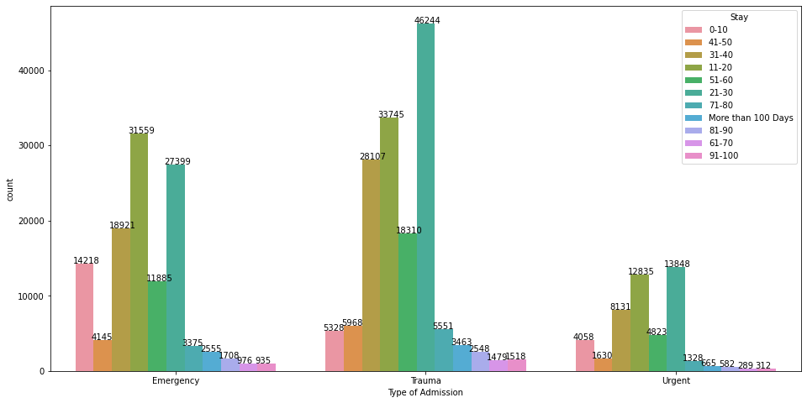
Observation:
* Emergency patients stayed mostly for 11-20 days
* There are more number Trauma patients who stayed for 21-30 days in hospital

Slide 8
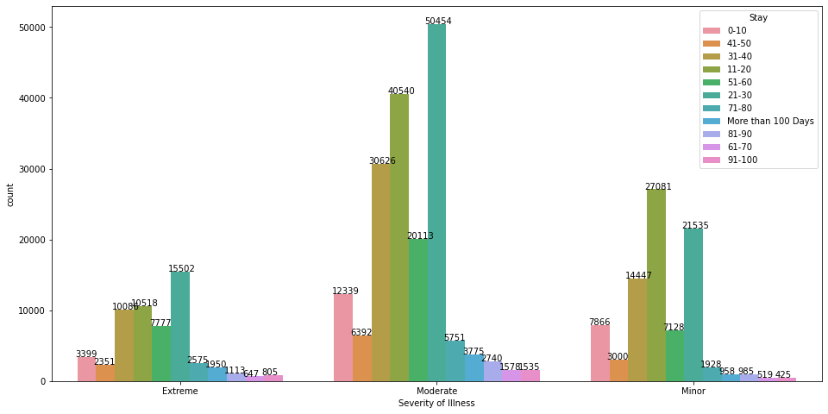
Observation:
* 175843 patients have Moderate Severity of illness.

Slide 9
Observations:
* Higher the number of visitors with patients, the probability of patients staying more than 100 days is higher.

Slide 10
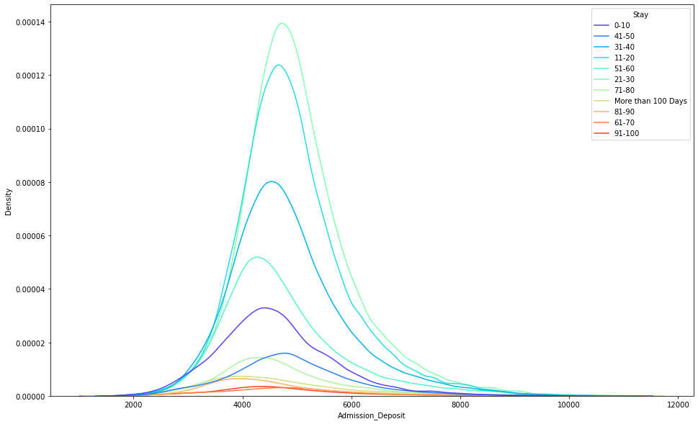
Observation:
* Admission Deposit amount are normally distributed, it falls mostly in range the between 4000 - 6000.

Slide 11
Preprocessing: * Replaced null values in bed grade by taking hospital code and imputed it with mode values. * Took unique Patient id of null values of data and replaced each patient Id with unique city code. Encoding: * Did Leave one out encoder to convert categorical variable into numerical variable.

Slide 12
Model Performances: Analytics Vidya Predicting Score * Logistic Regression - 31.1619140268742. * Naive Bayes - 17.599562230194 . * Decision Tree - 27.4396546482641. * Bagging Classifier - 34.7674347905393. * Random Forest - 38.6323009010981. * Ada boost - 34.3503374475588. * Gradient Boost - 40.54599623031556. * LGBM - 41.69879005289718. * XG Boost - 41.5504347297379. * Cat Boost - 42.4819115948197. * Voting - 41.8386331853834. * Stacking - 41.554082811455.

Slide 13
Conclusion: *On evaluating final test predictions, probably patients are staying for 21-30 days in the hospital. * Fail to reject the null hypothesis

Slide 14
Meaning:  New things are done more seriously.

Slide 15
PROVERB:  A bird in the hand is worth two in the bush

Slide 16
Meaning:  New things are done more seriously.

Slide 17
PROVERB:  Great minds think alike.

Slide 18
Meaning:  A humorous expression that is used when something else is thinking about the same thing you are thinking of.

Slide 19
PROVERB:  Better late than never .

Slide 20
Meaning:  It is better to do things late than not doing it.

Slide 21
PROVERB:  Every cloud has a silver lining .

Slide 22
Meaning:  You should never feel helpless because difficult times always lead to better days. .

Slide 23
PROVERB:  Make hay while the sun shines .

Slide 24
Meaning:  Take advantage of favourable circumstances because they might not last long. .

Slide 25
PROVERB:  Once bitten, Twice shy .

Slide 26
Meaning:  People who have been hurt once don’t risk doing the same thing again. .

Slide 27
PROVERB:  Out of the frying pan into the fire. .

Slide 28
Meaning:  Going from a bad situation to one that is even worse. .

Slide 29
PROVERB:  A stitch in time saves nine. .

Slide 30
PROVERB:  It is better to spend a little time to deal with problems straight away. If you keep waiting, things can only get worse. .

